Slide 1
Sprint Review: Salesforce BAU
Sprint 15
18 August – 14th September

Slide 2




Sprint Overview
Sprint Numbers
Sprint Links
Key Dates
Weeks
4
Sprint work Items Delivered
Enhancement Testing
8 – 12 September
Work Items Delivered
5
BAU Go Live
15th September
UAT Items Addressed
0
Story Points Completed
4.5

Slide 3
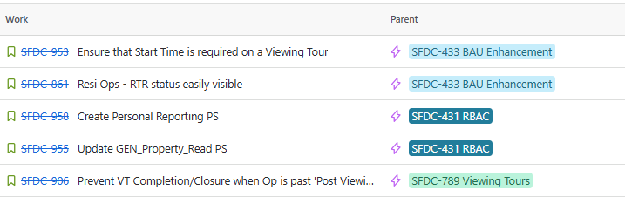
Work Items Delivered

Slide 4
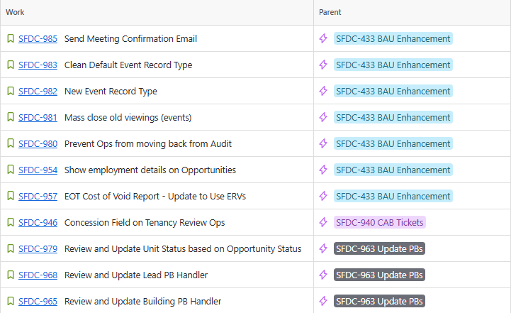
Work Items Planned for Next Sprint

Slide 5
General Items
Items Carried over to next Sprint | Reasons
RBAC - Create GREP Integration Permission Sets and Permission Set Group RBAC - Create Own Backup Permission Set/PSG RBAC - Data Team Permission Set Group CAB - Concession Calculations on Resi Ops | RBAC Items of lower priority CAB ticket delayed due to other CAB item dependencies
Risk | Contributing factors | Impact | Decisions taken
None
Issue | Contributing factors | Impact | Decisions taken
reCAPTCHA on Form Assembly forms impacting form performance |  | Alters how the form can be submitted, with conditional formatting and date inputs not displaying correctly | Hold off on release of SFDC-834. SFDC-863, and SFDC-865
Decision | Description | Date

Slide 6

Thank You

